Slide 1
Prediction of heart disease using machine learning
M Jahangir : F22BARIN7M01012
M Junaid : F22BARIN7M01002

Slide 2
ABSTRACT
Heart Attack is a term that assigns a large number of medical conditions related to heart. The key to Heart (Cardiovascular) diseases to evaluate large scores of data sets, compare information that can be used to predict, Prevent, Manage such as Heart attacks. Heart Disease is mainly because of stress, family backgrounds, High blood Pressure, etc… Data analytics is used to incorporate world for its valuable use to controlling, contravasting and Manage a large data sets. It can be applied with an much success to predict, prevent, Managing a Cardiovascular Diseases. To solve this we aims to implement the Data Analytics based on SVM and Genetic Algorithm to diagnosis of heart diseases. This result reveal the Genetic Algorithm as best optimized Prediction Models.

Slide 3
EXISTING SYSTEM
The World Health Organization (WHO) has estimated that 12 million deaths occur worldwide, every year
due to the Heart diseases.
About 25% deaths in the age group of 25-69 year occur because of heart diseases. In urban areas, 32.8%.

Slide 4
deaths occur because of heart ailments, while this percentage in rural areas is 22.9.
Over 80% of deaths in world are because of Heart disease. WHO estimated by 2030, almost 23.6 million.
people will die due to Heart disease.
The diagnosis of diseases is a significant and tedious task in medicine.
Treatment of the said disease is quite high and not affordable by most of the patients particularly in India.

Slide 5
PROPOSED SYSTEM
To predict the heart attack disease.
It helps in reducing treatment costs by providing effective treatments.
To find the parameters values in prediction like accuracy, elapsed time and energy consumption.

Slide 6
SYSTEM REQUIREMENT

Slide 7
HARDWARE CONFIGURATION
The below Hardware Specifications were used in both Server and Client machines when developing.
Processor : Intel(R) Core(TM) i3
Processor Speed : 3.06 GHz
Ram : 2 GB
Hard Disk Drive : 250 GB
Floppy Disk Drive : Sony
CD-ROM Drive : Sony
Monitor : “17” inches
Keyboard : TVS Gold
Mouse : Logitech

Slide 8
SOFTWARE CONFIGURATION
The below Software Specifications were used in both Server and Client machines when developing.
SERVER:
Operating System : Windows 7
Technology Used : Python
Database : My-Sql
Database Connectivity : Native Connectivity
Web Server : Apache
Browser : Internet Explorer 6.0
CLIENT:
Operating System : Windows 7
Browser : Internet Explorer 6.0

Slide 9
MODULES
Upload Training Data
Data Pre- Processing
Predicting Heart Disease
Graphical Representations

Slide 10
MODULES DESCRIBTION
Upload Training Data:
The process of rule generation advances in two stages. During the first stage, the SVM model is built using training data During each fold, this model is utilized for predicting the class labels The rules are evaluated on the remaining 10% of test data for determining the accuracy, precision, recall and F-measure. In addition, rule set size and mean rule length are also calculated for each fold of cross-validation.
2. Data Pre- Processing:
Heart disease data is pre-processed after collection of various records. The dataset contains a total of 303 patient records, where 6 records are with some missing values. Those 6 records have been removed from the dataset and the remaining 297 patient records are used in pre-processing. The multiclass variable and binary classification are introduced for the attributes of the given dataset.

Slide 11
Contd…
Predicting Heart Disease:
The training set is different from test set. In this study, we used this method to verity the universal applicability of the methods. In k-fold cross validation method, the whole dataset is used to train and test the classifier to Heart Stoke.
Graphical Representations:
The analyses of proposed systems are calculated based on the approvals and disapprovals. This can be measured with the help of graphical notations such as pie chart, bar chart and line chart. The data can be given in a dynamical data.

Slide 12
DATAFLOW DIAGRAM

Slide 13
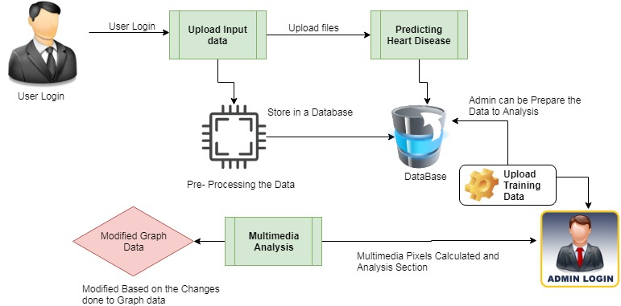
ARCHITECTURE DIAGRAM

Slide 14
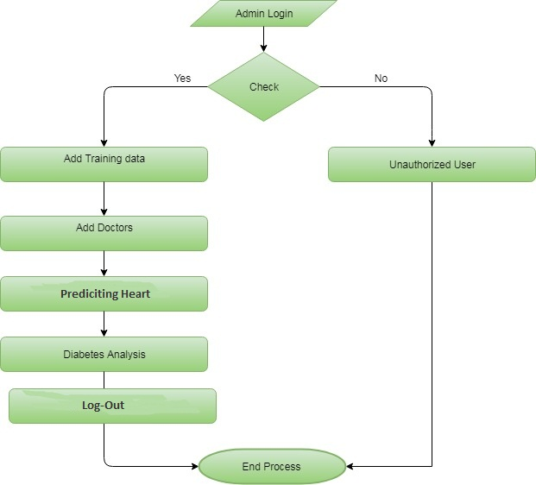
Admin

Slide 15
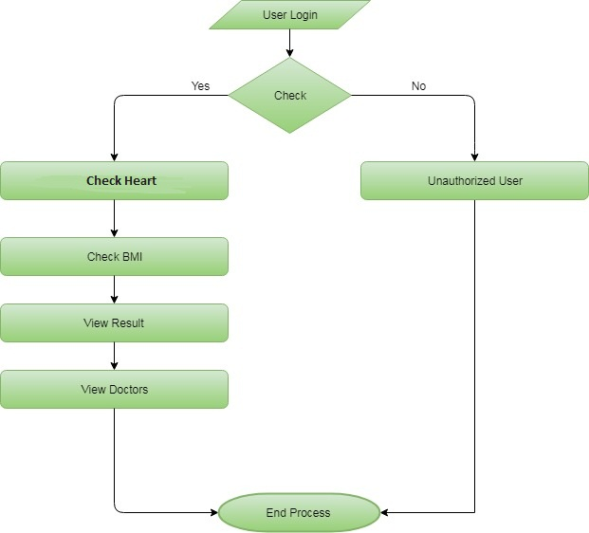
User

Slide 16
Models applied on dataset
Model: Random Forest
Cross-validation Accuracy: 0.66
Test Accuracy: 0.67
Model: Gradient Boosting
Cross-validation Accuracy: 0.65
Test Accuracy: 0.68
Model: Support Vector Machine
Cross-validation Accuracy: 0.58
Test Accuracy: 0.59

Slide 17
Models comparison
Model: Logistic Regression
Cross-validation Accuracy: 0.51
Test Accuracy: 0.49
Model: K-Nearest Neighbors
Cross-validation Accuracy: 0.57
Test Accuracy: 0.60
Model: Ada Boost
Cross-validation Accuracy: 0.59
Test Accuracy: 0.60
Model: Naive Bayes
Cross-validation Accuracy: 0.57
Test Accuracy: 0.55

Slide 18
Best model
The Best Model which is selected is:
GradientBoostingClassifier
Cross-validation Accuracy: 0.6453851744186047
Test Accuracy: 0.6811594202898551

Slide 19
Output of the model
There 5 categories of the output:
No heart disease
Mild heart disease
Moderate heart disease
Severe heart disease
Critical heart disease

Slide 20

Home Page

Slide 21
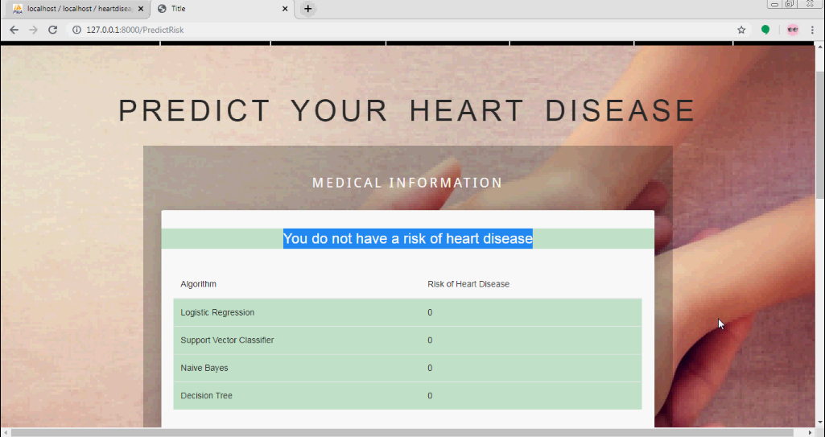
Contd…

Slide 22
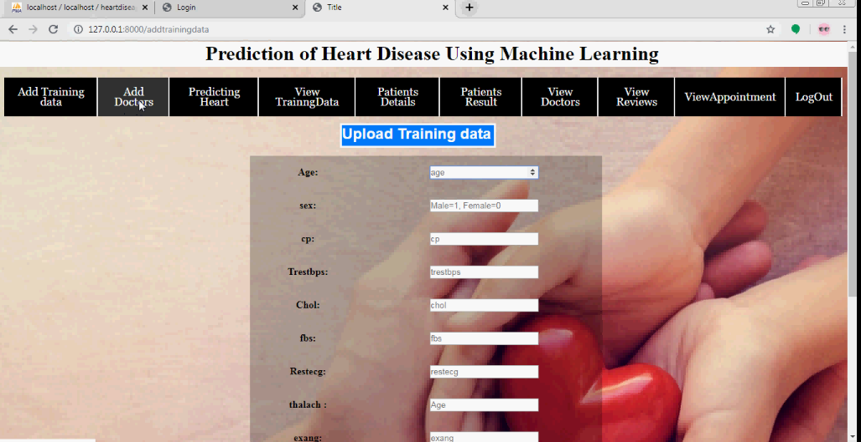
Upload Training Data

Slide 23
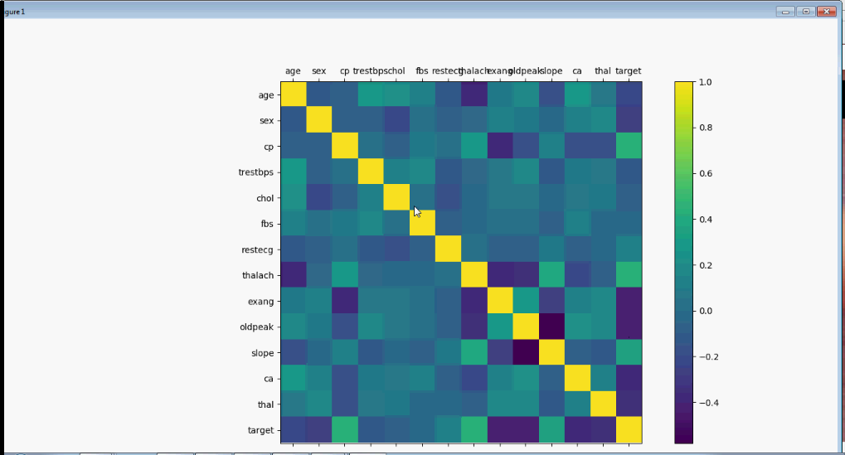
View Graph

Slide 24
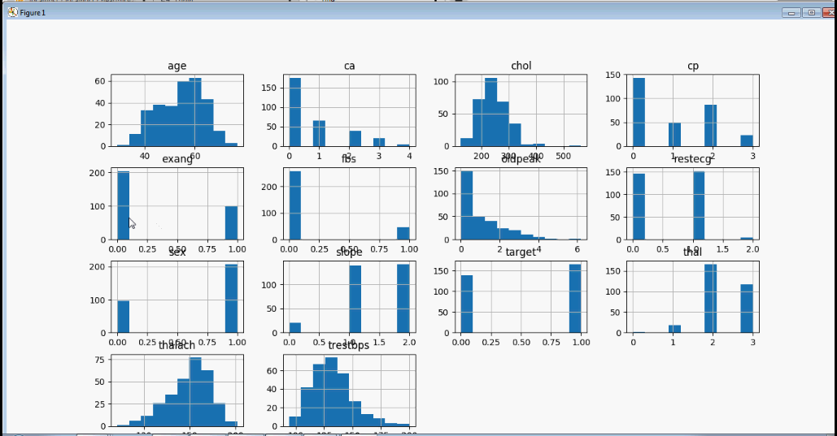
Contd…

Slide 25
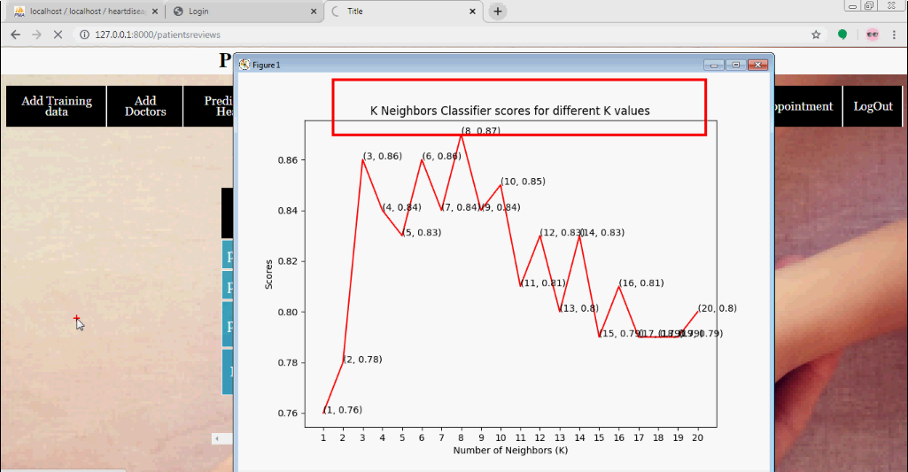
Contd…

Slide 26
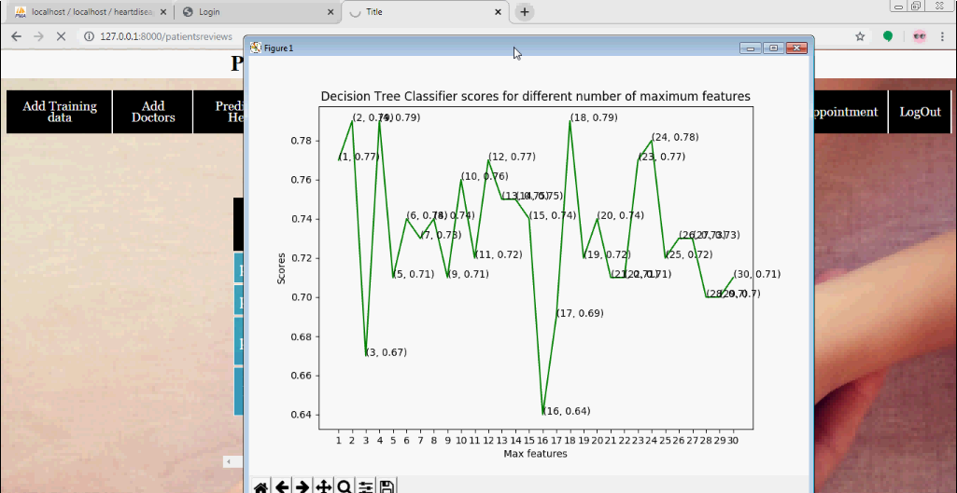
Contd…

Slide 27
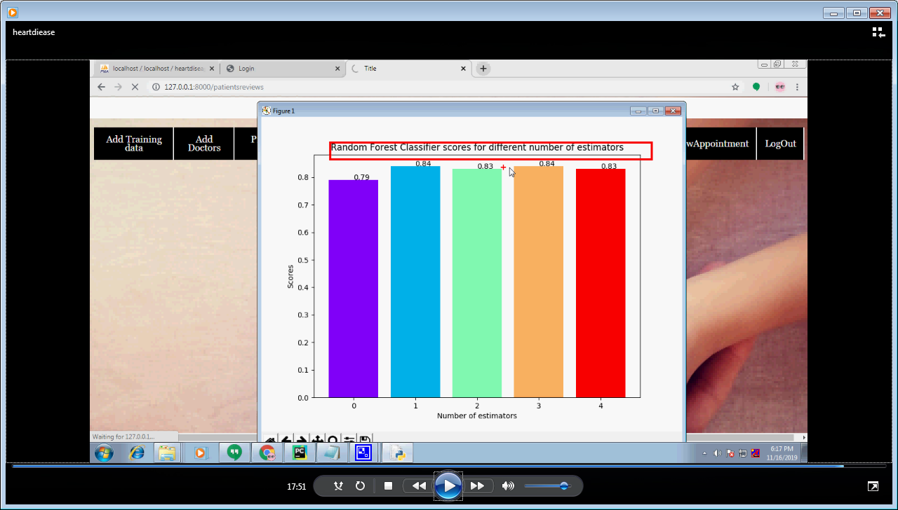
Contd…

Slide 28
FUTURE ENHANCEMENT
In future we can be made to produce an impact in the accuracy of the Decision Tree and Bayesian Classification for additional improvement after applying genetic
Algorithm in order to decrease the actual data for acquiring the optimal subset of attribute that is enough for heart disease prediction. The automation of heart disease prediction using actual real time data from health care organizations and agencies which can be built using big data. They can be fed as a streaming data and
By using the data, investigation of the patients in real time can be prepared.

Slide 29
CONCLUSION
Identifying the processing of raw healthcare data of heart information will help in the long term saving of human lives and early detection of abnormalities in heart conditions. Machine learning techniques were used in this work to process raw data and provide a new and novel discernment towards heart disease. Heat disease prediction is challenging and very important in the medical. However, the mortality rate can be drastically controlled if the disease is detected at the early stages and preventative measures are adopted as soon as possible. Further extension of this study is highly desirable to direct the investigations to real-world datasets instead of just theoretical approaches and simulations. The proposed hybrid HRFLM approach is used combining the characteristics of Random Forest (RF) and Linear Method (LM). HRFLM proved to be quite accurate in the prediction of heart disease. The future course of this research can be performed with diverse mixtures of machine learning techniques to better prediction techniques. Furthermore, new feature selection methods can be developed to get a broader perception of the significant features to increase the performance of heart disease prediction.

Slide 30


